Slide 1

DSC530 Final Project
Eric Vance

Slide 2
My Dataset
My dataset was downloaded from Kaggle, and the subject is NBA basketball shot selection from the 2014-2015 season.
This information was gathered by the NBA itself and made available to the public.
It includes several different fields, including the score of the game at the time of the shot, how much time was left on the shot clock, the distance of the shot, who shot it, and many more.
This data had tens of thousands of rows and was very comprehensive in nature.

Slide 3
Five Variables for Investigation
The goal of this exercise was to analyze shot data to see how different factors affected a shot's outcome. For example, does a shot have a lower percentage of going in when pressed for time? What shot distance is most likely to be made?
The five variables I chose were as follows:
SHOT_CLOCK: Signifies how much time was left on the shot clock when the shot was taken. Ranges from 0-24 seconds.
SHOT_DISTANCE: The distance away from the basket that the shot was taken from.
CLOSE_DEF_DISTANCE: How far away the closest defender to the shooter was.
DRIBBLES: How many dribbles the shooter took before attempting the shot.
TOUCH_TIME: How long the shooter actually held the ball in his possession before shooting.

Slide 4
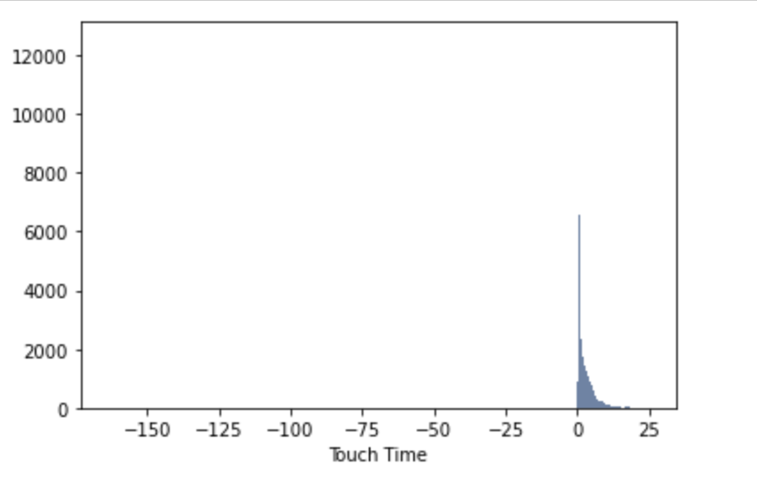
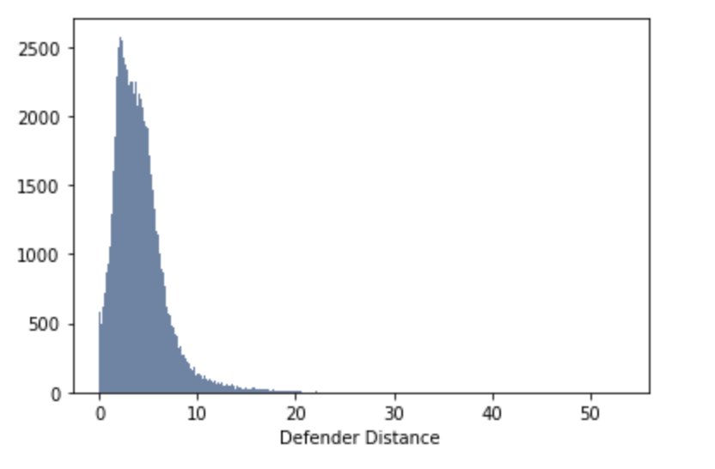
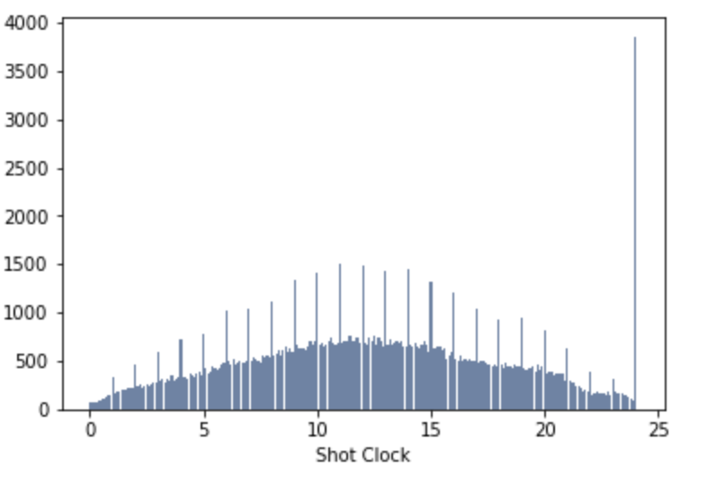
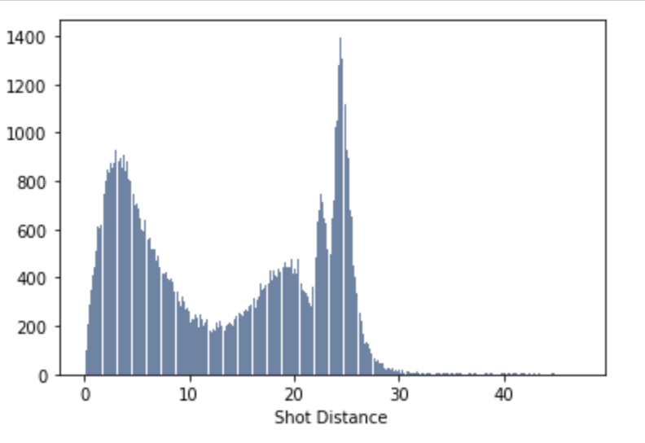
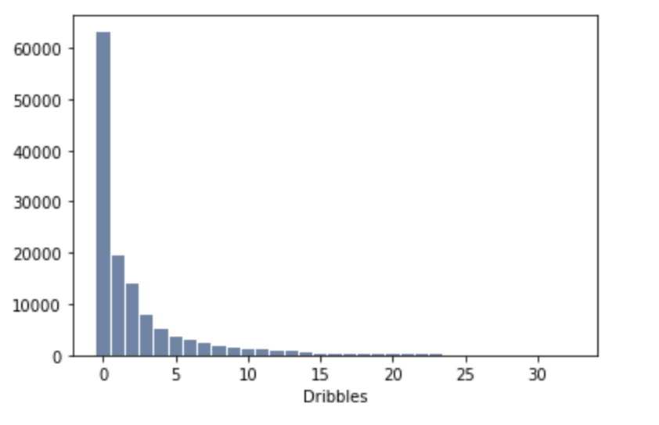
Histograms
Touch Time
Defender Distance
Shot Clock
Shot Distance
Dribbles

Slide 5
Explanation of Histograms
Shot Clock Distribution: Appears to be one outlier, at the 24 second mark. Need to investigate whether that means that more shots were taken with zero seconds left on the shot clock or with 24 seconds left.
Shot Distance: Appears to peak at around 27 feet. This is consistent with how long the three-point shot is in the NBA.
Defender Distance: Nothing looks out of the ordinary in this histogram.
Dribbles: Peaks at low amounts and slowly dwindles down. Nothing out of the ordinary.
Touch time: No outliers, just a peak between zero and one seconds. Consistent with catch-and-shoot offense in NBA

Slide 6
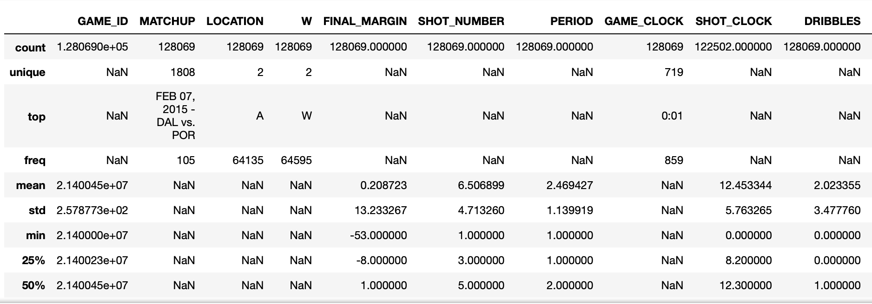
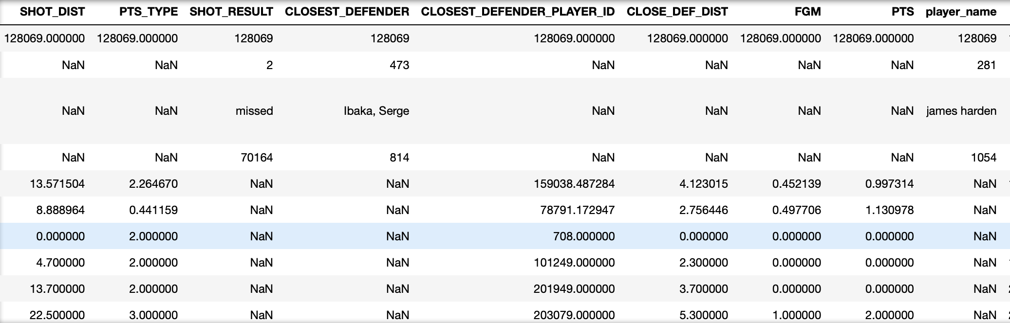
Descriptive Stats
This is the description of the data frame, giving various summary statistics. Will be discussed more in the summary.

Slide 7
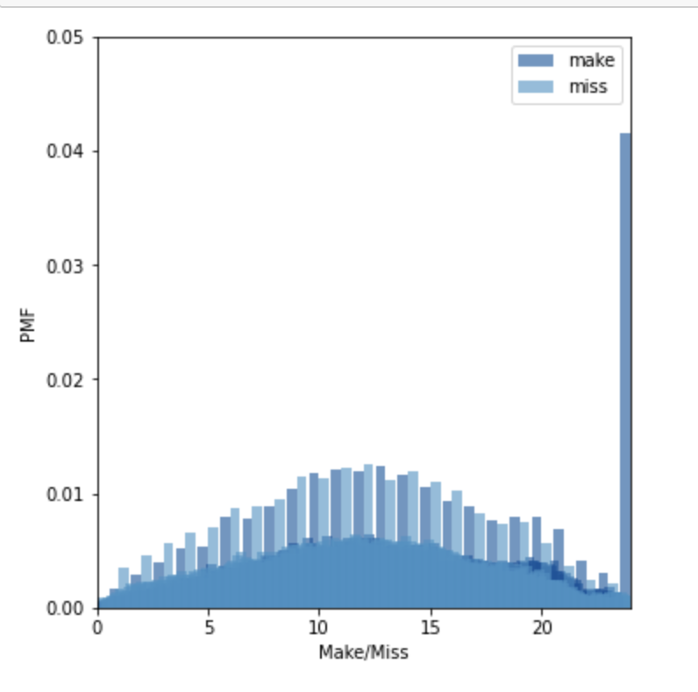
The PMF: Shot Clock
This PMF broke down makes vs misses based on remaining time in the shot clock.
There was not a whole lot of difference between the different times in the shot clock, aside from the 24 second mark itself.
Overall, it was useful in seeing the comparison between the two outcomes.

Slide 8
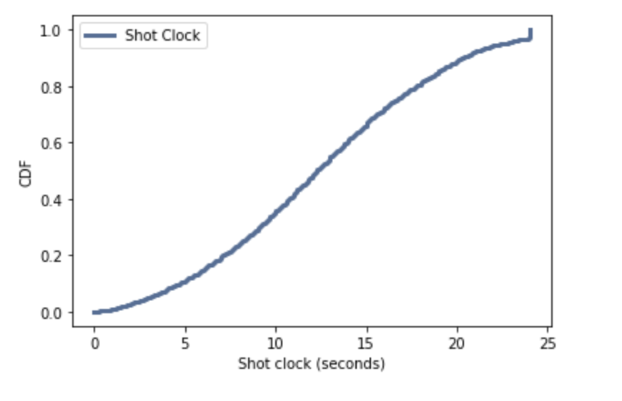
The CDF: Shot Clock
This is a CDF of the shot clock variable. Of course, at zero seconds it is 0% full and at 24 seconds it is at 100%.
It was interesting to me that this was so linear. That would suggest that there is no preferred time for a shot going off in the shot clock.

Slide 9
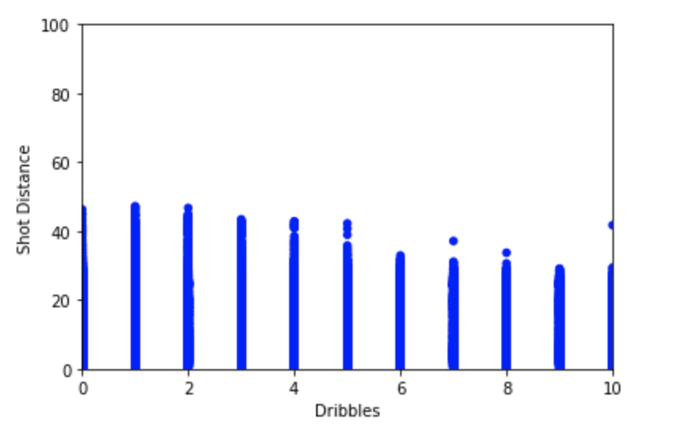
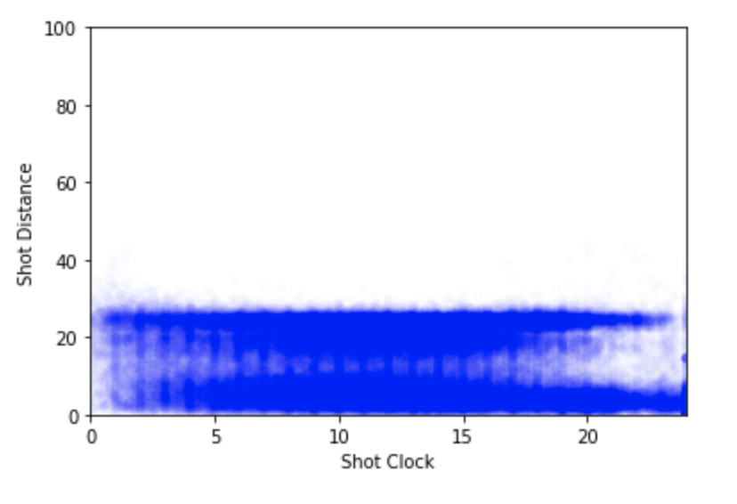
Two Scatter Plots
Dribbles vs Shot Distance: It appears that there is a slight drop-off in Shot Distance as the number of dribbles goes up.
Distance vs Shot Clock: The most notable part of this is the far right. It appears that shot distance gravitates towards either a layup or a three pointer as the shot clock expires.

Slide 10
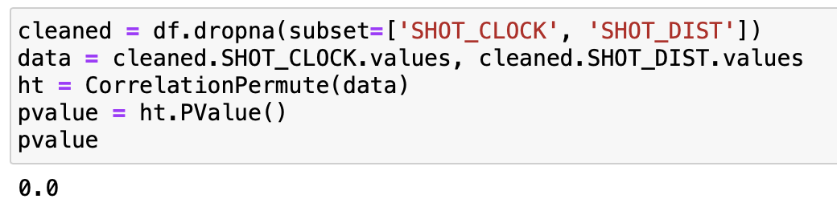
Hypothesis Test
Hypothesis: there is a difference between average time left on shot clock when it comes to shot distance.
After running the test, it turned out the p-value associated with the test came back as slightly over 0.00. This is under the conventional 0.05, meaning that this is a statistically significant test.

Slide 11
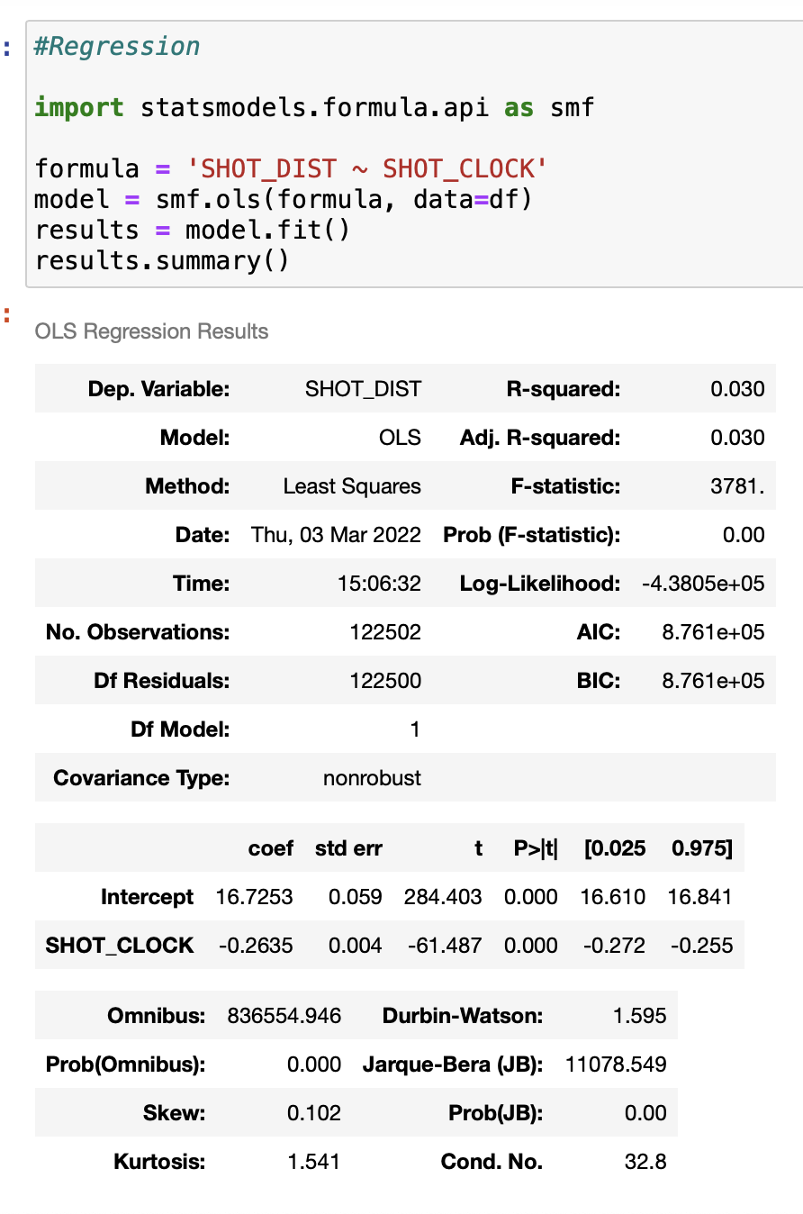
Regression
Here is the regression analysis done.
The predictor variable was shot clock time left and the reactant variable was the shot distance.
This was completed using the statsmodels library.

Slide 12
Thank you!
It was a pleasure being in this class, and I feel as if I learned a lot. My one piece of negative feedback would be an overreliance on the code from the book, as that may be tough to use out in the real world. But again, thank you so much for the great semester!

